Slide 1
National Economic Education Delegation
Vision
  One day, the public discussion of policy issues will be grounded in an accurate perception of the underlying economic principles and data.
Mission
  NEED unites the skills and knowledge of a
  vast network of professional economists to promote understanding of the economics of policy issues in the United States.
NEED Presentations
  Are nonpartisan and intended to reflect the consensus of the economics profession.

Slide 2
International Trade and the Pandemic
Alan V. Deardorff
University of Michigan
Webinar on International Trade
Bank of Canada & LEO, University of Orleans
May 27, 2021

Slide 3
Overview
This workshop is (I was told)
  “focused on but not restricted to the Impact of the Covid-19 Pandemic on International Trade”
Cases of the Pandemic
  Started in China
  Spread to the world in two (or three) waves, so far
  Hit
    The Americas and Europe especially hard
    Later, developing countries, esp. India
  Deaths surged early and then grew more slowly than cases as treatments improved

Slide 4
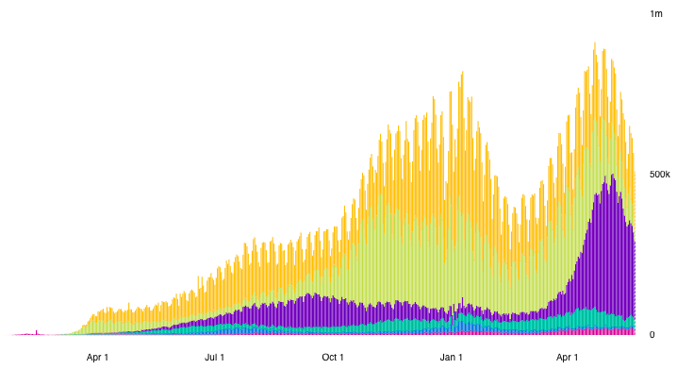
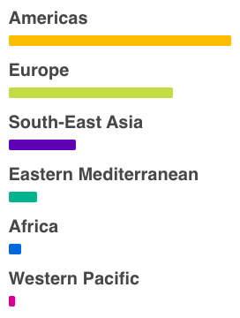
Cases
Daily Confirmed Cases
Source: WHO Coronavirus Disease (COVIC-19) Dashboard as of May 24, 2021
Notes:
WHO Coronavirus Disease (COVIC-19) Dashboard
https://covid19.who.int/?gclid=CjwKCAiAuoqABhAsEiwAdSkVVNd67qw_hEb4v9v3UxACJd_csZMJl8Yc5UjaAIYt53KJWSQiXZPlRxoCm0kQAvD_BwE

Slide 5
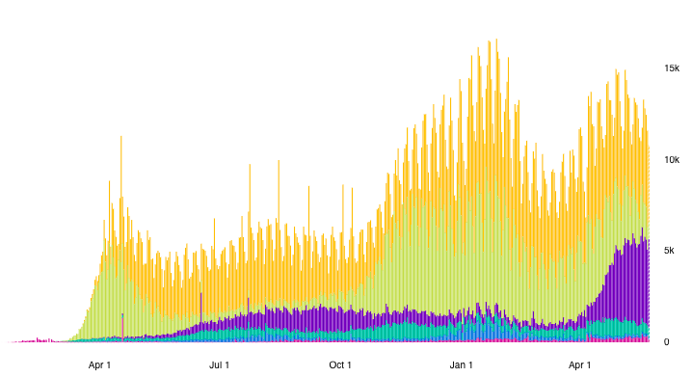
Deaths
Daily Deaths
Source: WHO Coronavirus Disease (COVIC-19) Dashboard as of Apr 26, 2021
Notes:
WHO Coronavirus Disease (COVIC-19) Dashboard
https://covid19.who.int/?gclid=CjwKCAiAuoqABhAsEiwAdSkVVNd67qw_hEb4v9v3UxACJd_csZMJl8Yc5UjaAIYt53KJWSQiXZPlRxoCm0kQAvD_BwE

Slide 6
Overview
Trade Policy Responses
  Included both
    Import facilitation, and
    Export restriction
  Both highest for medical and high for food
  Facilitation was somewhat more common than restriction
  Both began before cases surged

Slide 7
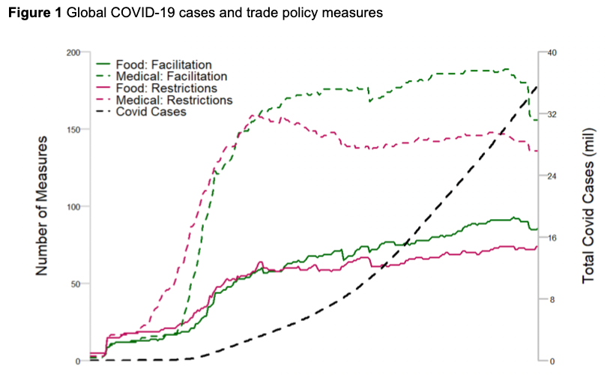
Medical
Food
Source: Evenett et al.
Notes:
Evenett, Simon, Matteo Fiorini, Johannes Fritz, Bernard Hoekman, Piotr Lukaszuk, Nadia Rocha,Michele Ruta, Filippo Santi, Anirudh Shingal, “Trade policy responses to the COVID-19 pandemic: Evidence from a new dataset,” VOXEU, December 11, 2020.
https://voxeu.org/article/trade-policy-responses-covid-19-pandemic-new-dataset

Slide 8
International Trade and the Pandemic
Outline
Causes of the Pandemic
Effects of the Pandemic
  On Trade
  On Trade Policies
Role of Trade During the Pandemic
  PPE and medical supplies
  Vaccines

Slide 9
Causes of the Pandemic

Slide 10
Causes of the Pandemic
Does trade cause new infections?
  No. These arise from mutations, often in animals and then spread to humans
Does trade spread infections?
  Yes. Trade requires movement of people across borders, carrying infections
  The Black Death (bubonic plague)
    “is believed to have been spread by both land and sea, originating in China and following the trade routes to Europe and the Middle East.”
  The 1918 Spanish Flu: but spread more by soldiers than by trade
Notes:
Salvatore Babones, “The ‘Chinese Virus’ Spread Along the New Silk Road,” Foreign Policy, April 6, 2020.
https://foreignpolicy.com/2020/04/06/chinese-coronavirus-spread-worldwide-on-new-silk-road/

Slide 11
Causes of the Pandemic
Studies Relate Globalization and Spread of Pandemic
  Zimmermann et al. find, across countries:
    Infection rate rises with globalization
    Transmission speed rises with globalization
    Fatalities fall with globalization
      (but probably because globalization is correlated with higher incomes and thus better treatment)
  Farzanegan et al. report similarly
Notes:
Zimmermann, Klaus F., Gokhan Karabulut, Mehmet Huseyin Bilgin, and Asli Cansin Doker, “Inter-country distancing, globalisation and the coronavirus pandemic,” World Economy 43(6), June 2020, pp. 1484-1498.
Farzanegan, Mohammad Reza, Mehdi Feizi, and Hassan F. Gholipour, “Globalization and Outbreak of COVID-19: An Empirical Analysis,” CESifo Working Paper No. 8315, May 2020.

Slide 12
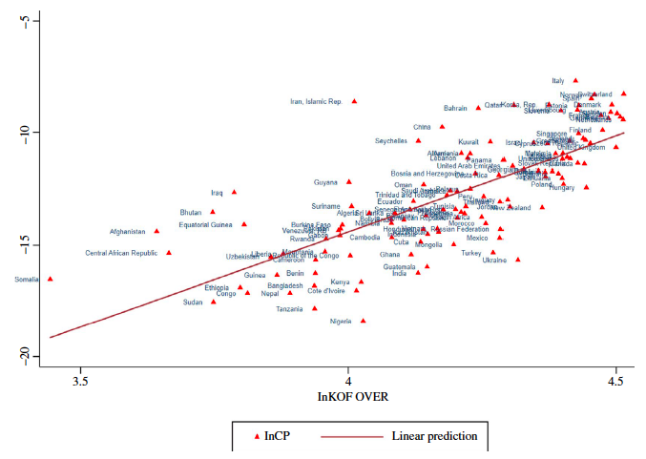
    Infection rates rise with globalization
Infection Rate
(Globalization)
Source: Zimmermann et al. (2020)
Notes:
Zimmermann, Klaus F., Gokhan Karabulut, Mehmet Huseyin Bilgin, and Asli Cansin Doker, “Inter-country distancing, globalisation and the coronavirus pandemic,” World Economy 43(6), June 2020, pp. 1484-1498.

Slide 13
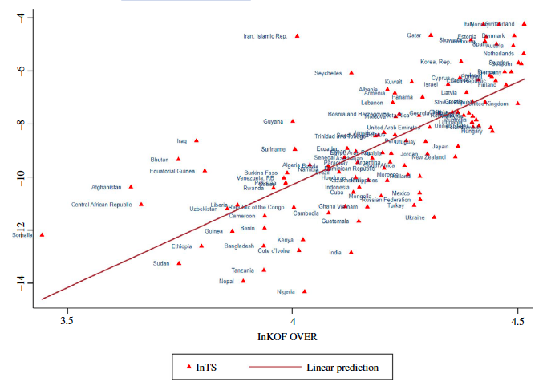
    Transmission speed rises with globalization
Transmission Speed
(Globalization)
(Globalization)
Source: Zimmermann et al. (2020)
Notes:
Zimmermann, Klaus F., Gokhan Karabulut, Mehmet Huseyin Bilgin, and Asli Cansin Doker, “Inter-country distancing, globalisation and the coronavirus pandemic,” World Economy 43(6), June 2020, pp. 1484-1498.

Slide 14
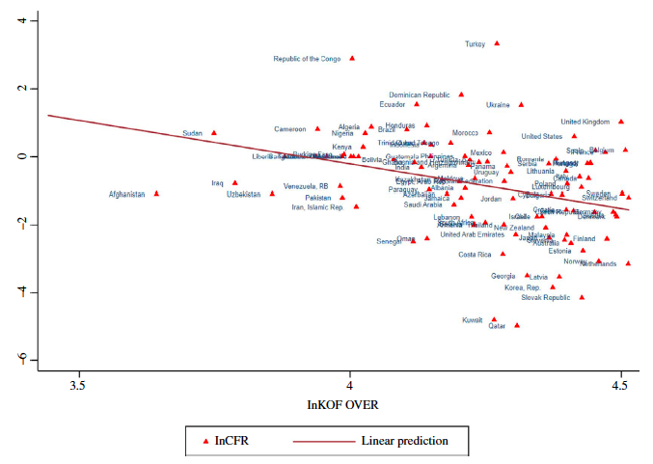
    Fatalities fall with globalization
Fatality Ratio
(Globalization)
(Globalization)
Source: Zimmermann et al. (2020)
Notes:
Zimmermann, Klaus F., Gokhan Karabulut, Mehmet Huseyin Bilgin, and Asli Cansin Doker, “Inter-country distancing, globalisation and the coronavirus pandemic,” World Economy 43(6), June 2020, pp. 1484-1498.

Slide 15
Causes of the Pandemic
Globalization and Spread of Pandemic
  Note that globalization is not just trade
  It includes
    International trade and investment
    International tourism
    International students
    Migration
    International transportation
Notes:
Zimmermann, Klaus F., Gokhan Karabulut, Mehmet Huseyin Bilgin, and Asli Cansin Doker, “Inter-country distancing, globalisation and the coronavirus pandemic,” World Economy 43(6), June 2020, pp. 1484-1498.

Slide 16
Effects on Trade

Slide 17
Effects on Economies
Effects on Trade
  Trade plummets
  Travel halted
  Shipping declines
  Supply chains disrupted

Slide 18
Trade
Effects on Economies

Slide 19
Effects on Economies
Trade
  Pandemic was expected to reduce world trade, and it did
  US was typical; China, was not
  Trade with China was crucial for dealing with pandemic
  Trade in many products were affected
  Global trade has now recovered

Slide 20
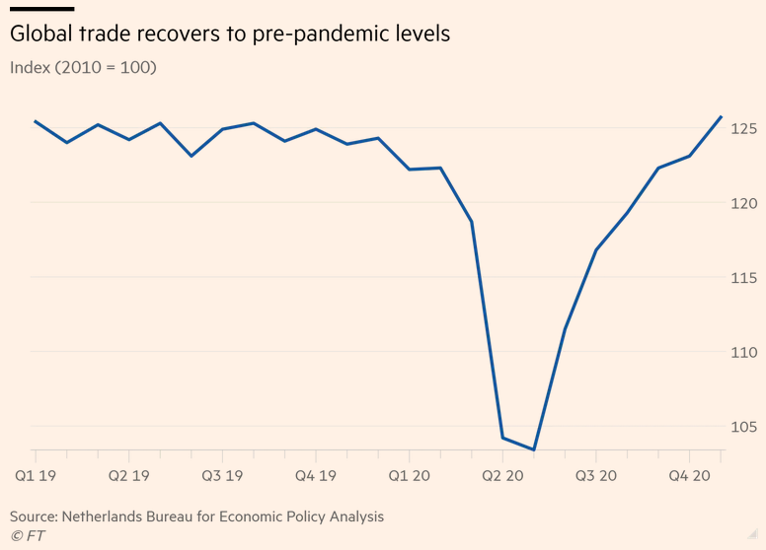
Source:
Financial Times,
Jan 25, 2021
Notes:
Romei, Valentina, “Global trade recovers to pre-pandemic level,” Financial Times, January 25, 2021
https://www.ft.com/content/add4d744-30da-4df4-b703-80488c1b3104

Slide 21
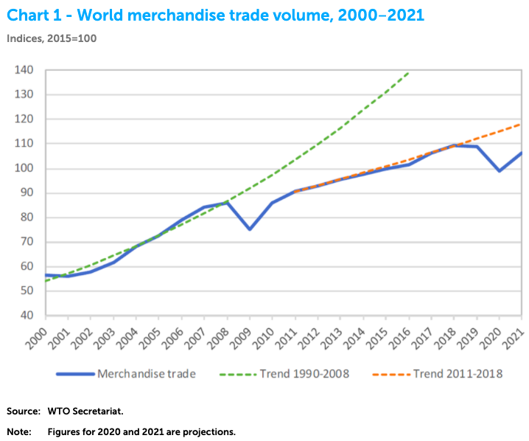
Source: WTO
Oct 6, 2020
Notes:
WTO, Oct 6. 2020
https://www.wto.org/english/news_e/pres20_e/pr862_e.htm

Slide 22
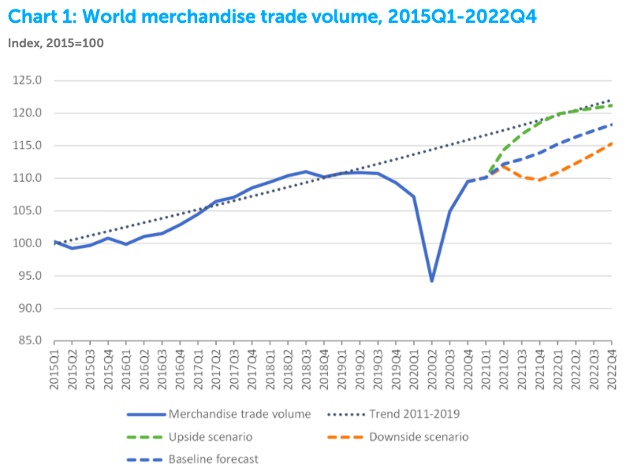
Source: WTO
Mar 31, 2021
Notes:
WTO, Mar 31. 2021
https://www.wto.org/english/news_e/pres21_e/pr876_e.htm

Slide 23
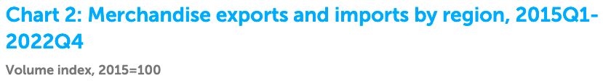
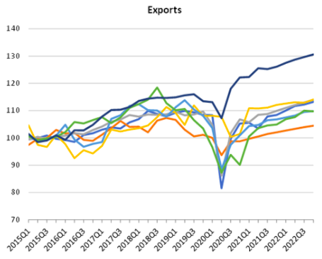
Exports
Source: WTO
Mar 31, 2021
Notes:
WTO, Mar 31. 2021
https://www.wto.org/english/news_e/pres21_e/pr876_e.htm

Slide 24
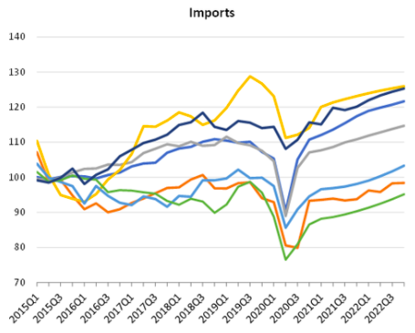
Imports
Source: WTO
Mar 31, 2021
Notes:
WTO, Mar 31. 2021
https://www.wto.org/english/news_e/pres21_e/pr876_e.htm

Slide 25
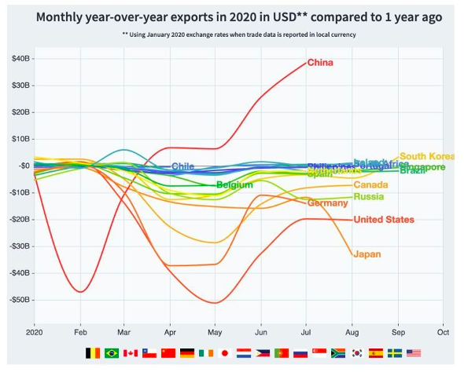
Source: World Economic Forum
Nov 8, 2020
Notes:
How COVID-19 has affected trade, in 8 charts, World Economic Forum, Nov 8, 2020
https://www.weforum.org/agenda/2020/11/how-covid-19-has-reshuffled-international-trade/

Slide 26
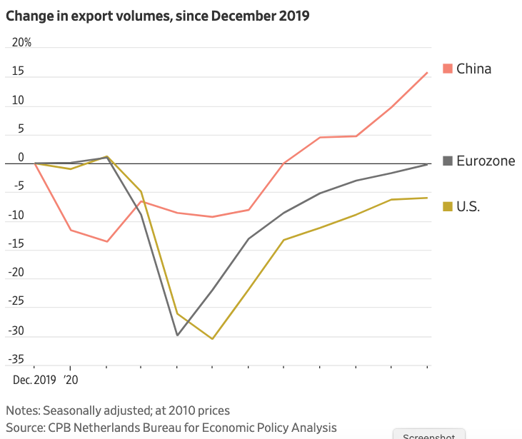
Source: Wall Street Journal
Feb 26, 2021
Notes:
Hannon, Paul, “Global Trade Roars Back From Depths of Covid-19 Pandemic,” Wall Street Journal, February 26, 2021.
https://www.wsj.com/articles/global-trade-roars-back-from-depths-of-covid-19-pandemic-11614253037?mod=itp_wsj&ru=yahoo

Slide 27
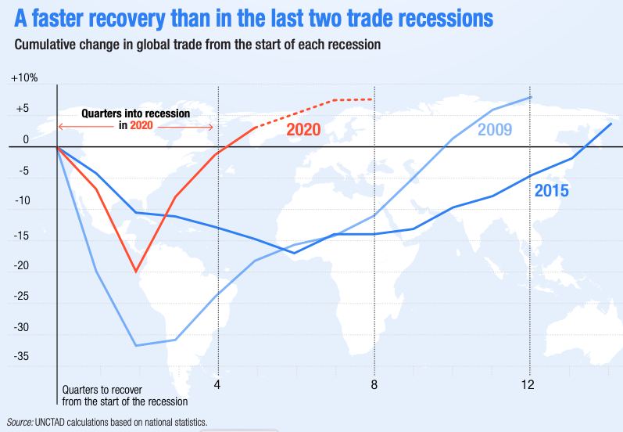
Source: UNCTAD May 2021
Notes:
UNCTAD, Global Trade Update, May 2021
https://unctad.org/system/files/official-document/ditcinf2021d2_en.pdf

Slide 28
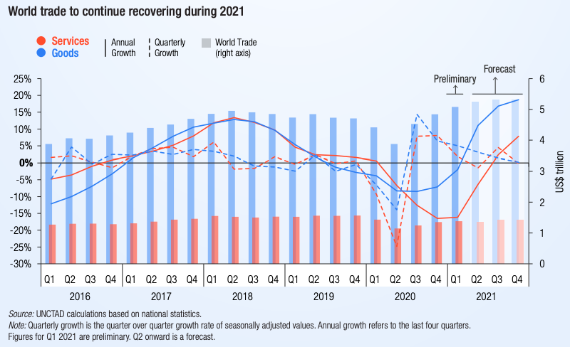
Source: UNCTAD May 2021
Notes:
UNCTAD, Global Trade Update, May 2021
https://unctad.org/system/files/official-document/ditcinf2021d2_en.pdf

Slide 29
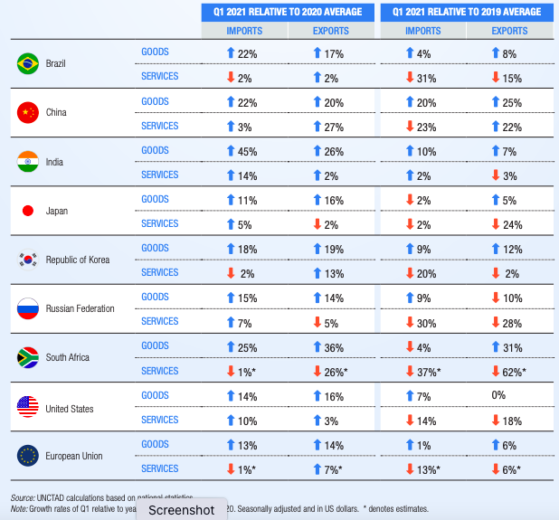
Source: UNCTAD May 2021
Notes:
UNCTAD, Global Trade Update, May 2021
https://unctad.org/system/files/official-document/ditcinf2021d2_en.pdf

Slide 30
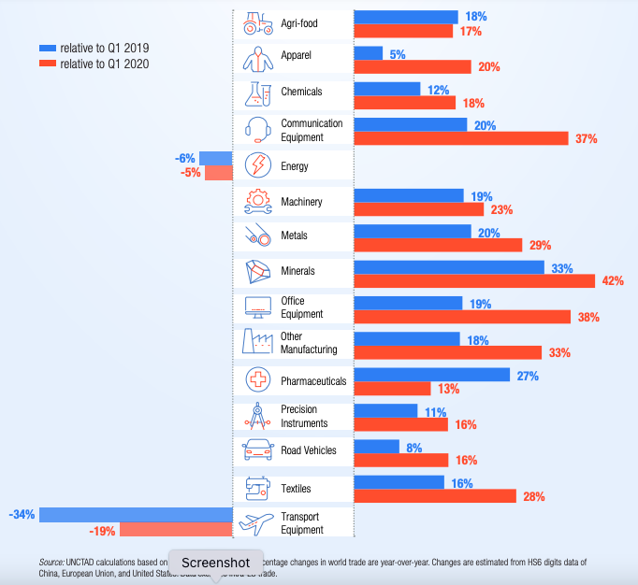
Source: UNCTAD May 2021
Notes:
UNCTAD, Global Trade Update, May 2021
https://unctad.org/system/files/official-document/ditcinf2021d2_en.pdf

Slide 31
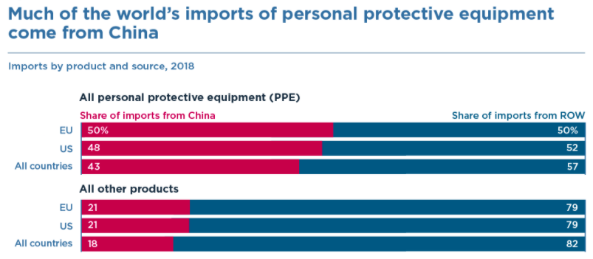
Source: Bown (2020)
Notes:
Bown (2020), “COVID-19: China's exports of medical supplies provide a ray of hope,” PIIE
https://www.piie.com/blogs/trade-and-investment-policy-watch/covid-19-chinas-exports-medical-supplies-provide-ray-hope

Slide 32
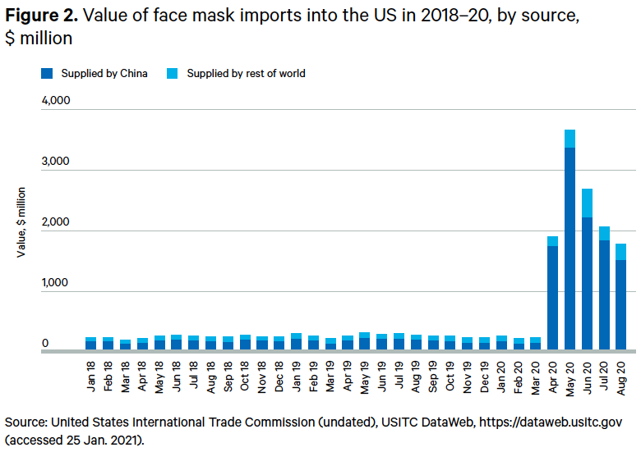
Source: Evenett (2021)
Notes:
Evenett, Simon J., “Trade policy and medical supplies during COVID-19,” Briefing Paper, Global Economy and Finance Program, Chatham House, April 2021
https://www.globaltradealert.org/reports/67

Slide 33
Travel
Effects on Economies

Slide 34
Effects on Economies
Travel
  Fell drastically and has only partially recovered
  Symptoms
    Passengers
    Airline stock prices
  Reasons:
    Travel restrictions and border closures
    Delays at border

Slide 35
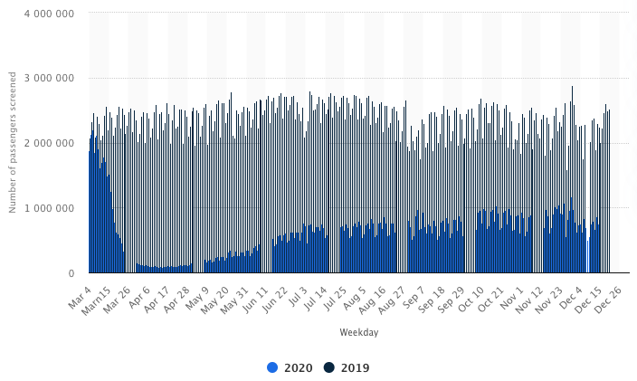
Daily number of passengers screened at TSA checkpoints in the United States from March 2019 to December 2020
Source: Statista
Notes:
Statista, downloaded 1/12/21
https://www.statista.com/statistics/1107016/coronavirus-tsa-checkpoint-travel-numbers-us-airports/

Slide 36
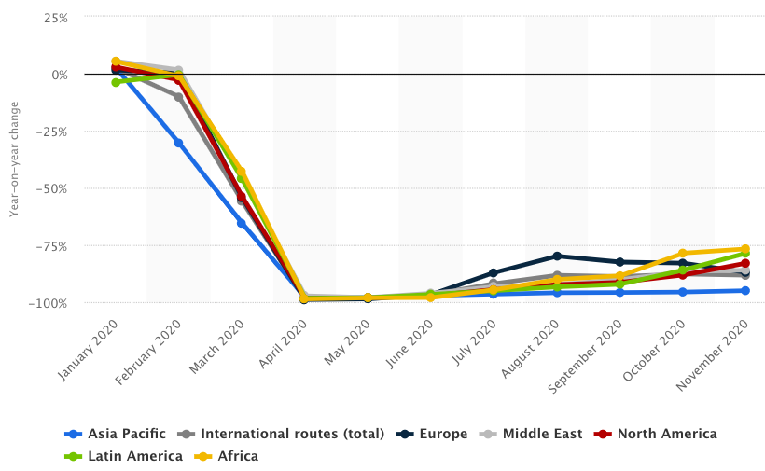
Year-on-year revenue-passenger kilometer (RPK) change on international routes from January to November 2020, by region
Source: Statista
Notes:
Statista, downloaded 1/12/21
https://www.statista.com/statistics/234977/revenue-passenger-kilometers-on-international-flights/

Slide 37
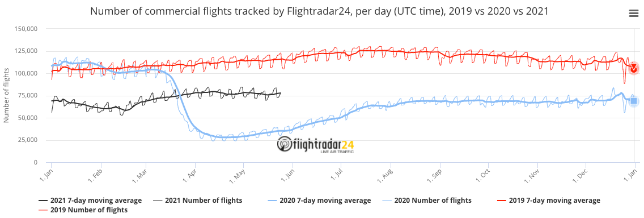
Source: flightrader24, May 25, 2021
Notes:
flightrader24, May 25, 2021
https://www.flightradar24.com/data/statistics

Slide 38
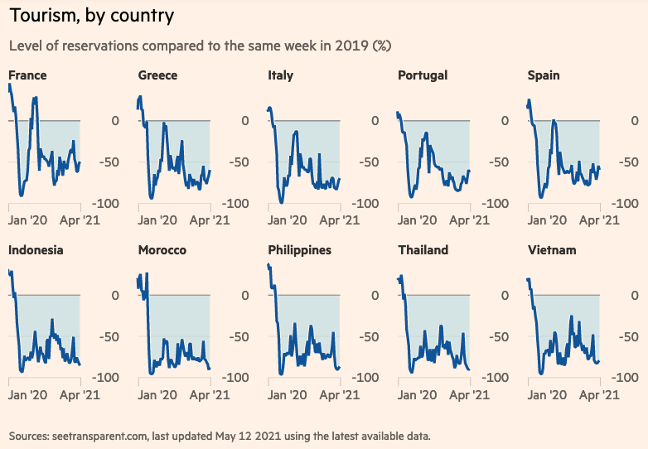
Source: FT 5/14/21
Notes:
“Pandemic crisis: Global economic impact tracker,” Financial Times, May 14, 2021
https://www.ft.com/content/272354f2-f970-4ae4-a8ae-848c4baf8f4a

Slide 39
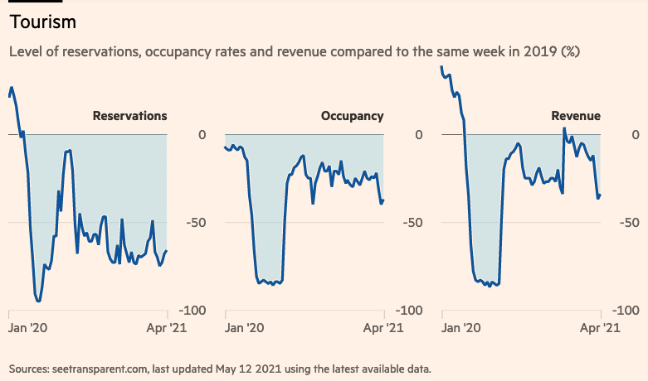
Source: FT 5/14/21
Notes:
“Pandemic crisis: Global economic impact tracker,” Financial Times, May 14, 2021
https://www.ft.com/content/272354f2-f970-4ae4-a8ae-848c4baf8f4a

Slide 40
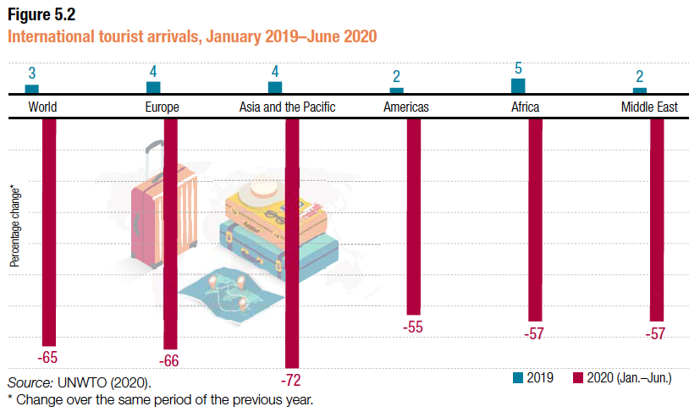
Source: UNCTAD
Notes:
UNCTAD,
https://unctad.org/webflyer/impact-covid-19-pandemic-trade-and-development-transitioning-new-normal Impact of the Covid-19 Pandemic on Trade and Development, 2020.

Slide 41
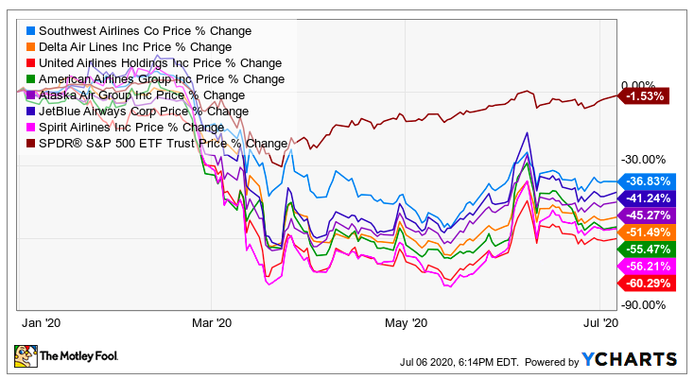
Airline Stock Prices
Notes:
The Motley Fool, July 6, 2020
https://www.fool.com/investing/2020/07/09/should-you-buy-or-sell-airline-stocks-right-now.aspx
Looked for a more recent graph, but the only one I found 1/12/21 didn’t include the broader index.

Slide 42
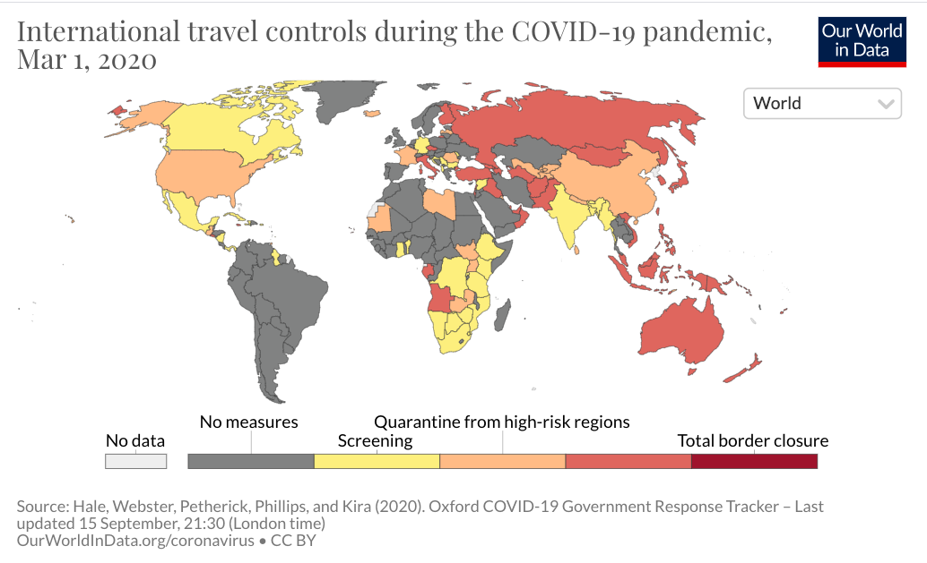
International travel controls during the COVID-19 pandemic, Mar 1, 2020
Notes:
Our World in Data
https://ourworldindata.org/grapher/international-travel-covid

Slide 43
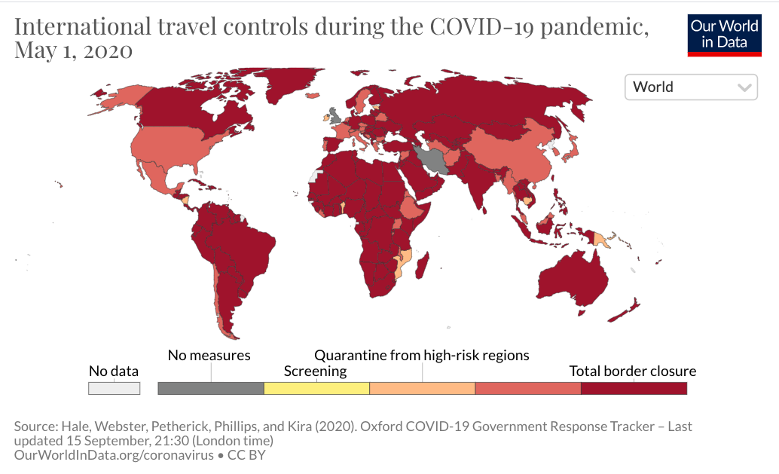
International travel controls during the COVID-19 pandemic, May 1, 2020
Notes:
Our World in Data
https://ourworldindata.org/grapher/international-travel-covid

Slide 44
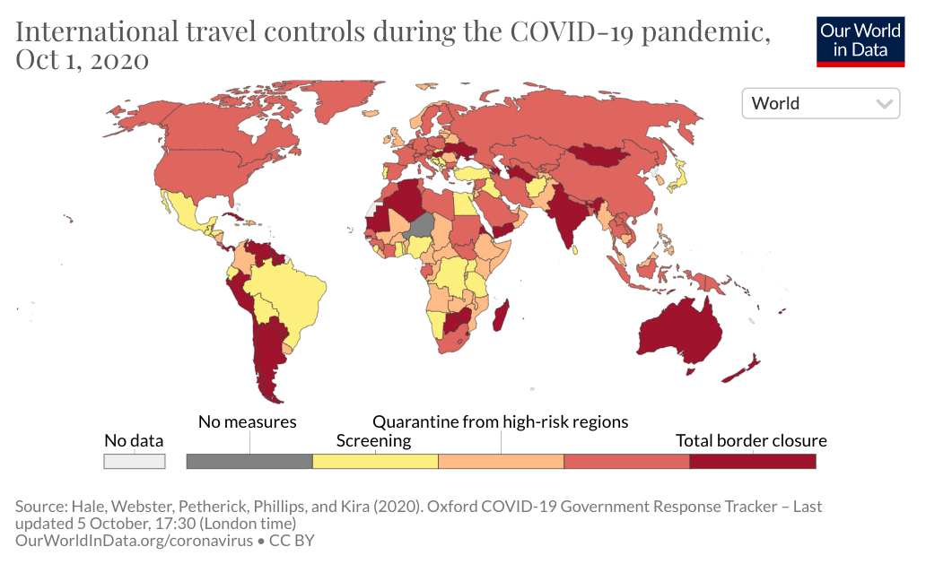
International travel controls during the COVID-19 pandemic, Oct 1, 2020
Notes:
Our World in Data
https://ourworldindata.org/grapher/international-travel-covid

Slide 45
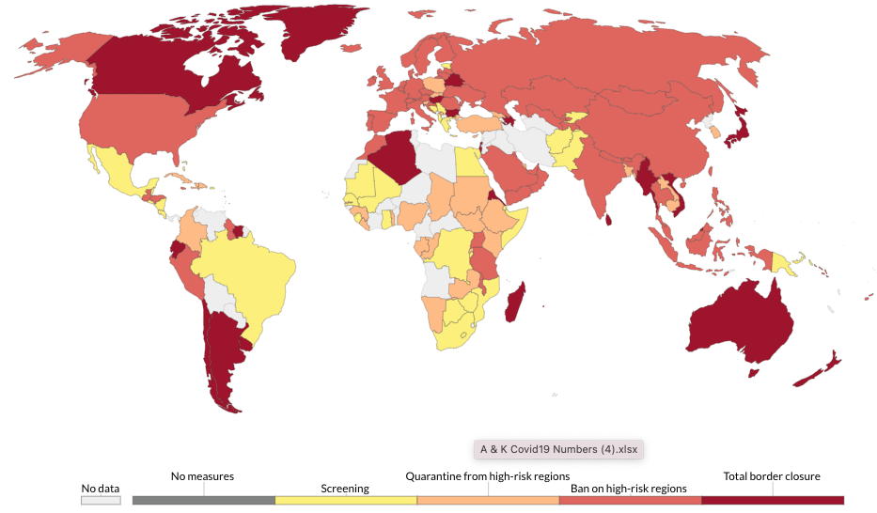
International travel controls during the COVID-19 pandemic, May 15, 2021
Notes:
Our World in Data
https://ourworldindata.org/grapher/international-travel-covid

Slide 46
Shipping
Effects on Economies

Slide 47
Effects on Economies
Shipping by Sea
  Drop in trade reduced demand at first
    Then increased demand for restocking
  Pandemic added restrictions
    At ports
    For crews
  Shipping rates rose

Slide 48
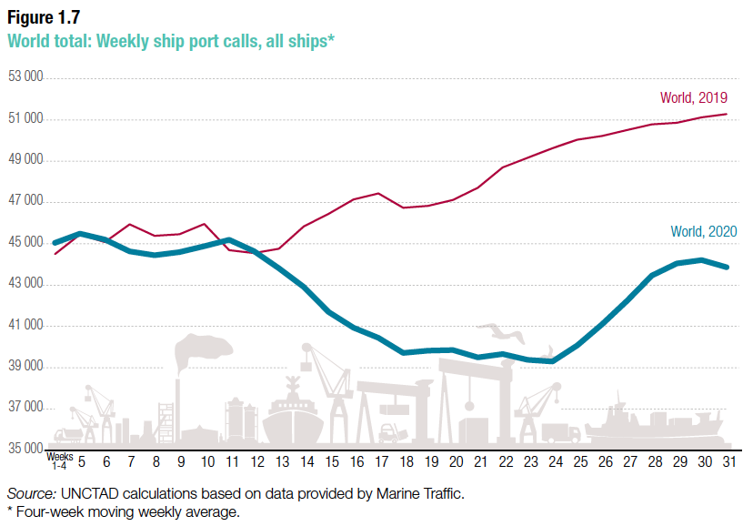
Source: UNCTAD
Notes:
UNCTAD,
https://unctad.org/webflyer/impact-covid-19-pandemic-trade-and-development-transitioning-new-normal Impact of the Covid-19 Pandemic on Trade and Development, 2020.

Slide 49
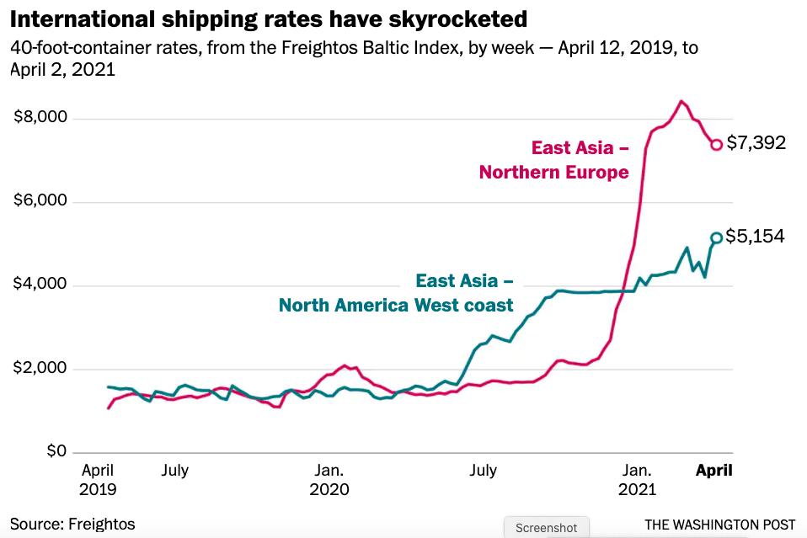
Source: Telford & Bogage, Apr 9, 2021
Notes:
Telford, Taylor and Jacob Bogage, “Essential, invisible: Covid has 200,000 merchant sailors stuck at sea,” Washington Post, April 9, 2021.
https://www.washingtonpost.com/health/2021/04/09/maritime-workers-pandemic-global-trade/?utm_campaign=wp_todays_headlines&utm_medium=email&utm_source=newsletter&wpisrc=nl_headlines&carta-url=https%3A%2F%2Fs2.washingtonpost.com%2Fcar-ln-tr%2F31d1102%2F6072c8a89d2fda1dfb4b2316%2F597273baade4e21a847d94bd%2F46%2F57%2F6072c8a89d2fda1dfb4b2316

Slide 50
Effects on Economies
Shipping by Air
  This too was hurt, as fewer passenger flights also carried less cargo

Slide 51
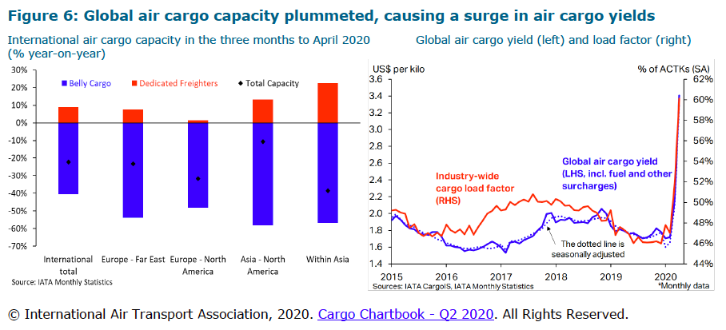
Source: WTO (2020)
Notes:
WTO, “Trade Costs in the Time of Global Pandemic,” information note, World Trade Organization, August 12, 2020.
https://www.wto.org/english/tratop_e/covid19_e/trade_costs_report_e.pdf

Slide 52
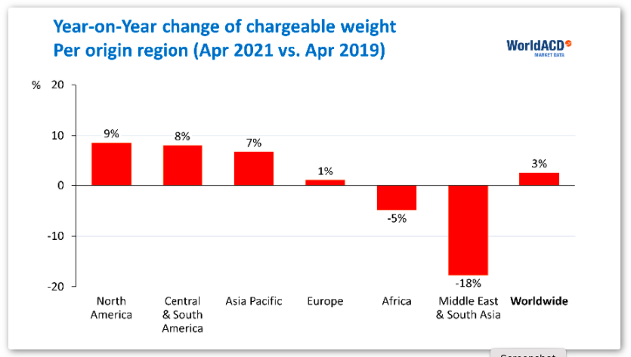
Year-on-
2-Year
Source: AJOT May 17, 2021
Notes:
AJOT, “Air cargo volumes back to normal, rates still go up, but drop 12% year-on-year,” American Journal of Transportation, May 17, 2021
https://ajot.com/news/air-cargo-volumes-back-to-normal-rates-still-go-up-but-drop-12-year-on-year

Slide 53
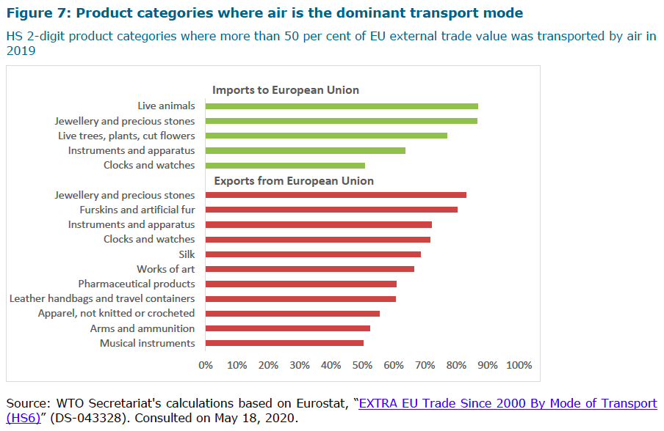
Source: WTO
(2020)
Notes:
WTO, “Trade Costs in the Time of Global Pandemic,” information note, World Trade Organization, August 12, 2020.
https://www.wto.org/english/tratop_e/covid19_e/trade_costs_report_e.pdf

Slide 54
Supply Chains
Effects on Economies

Slide 55
Effects on Economies
Supply Chains
  Globalization has created long and complex international supply chains
  These are vulnerable to the shocks of the pandemic

Slide 56
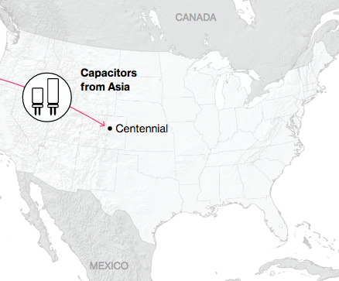
NAFTA and the Auto Supply Chain
Black, Diamond, and Merrill, “One Tiny Widget’s Dizzying Journey Shows Just How Critical Nafta Has Become,” Bloomberg, February 2, 2017.

Slide 57
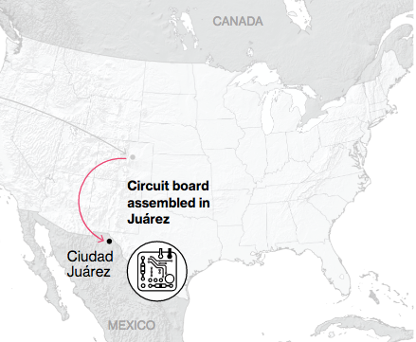
NAFTA and the Auto Supply Chain
Black, Diamond, and Merrill, “One Tiny Widget’s Dizzying Journey Shows Just How Critical Nafta Has Become,” Bloomberg, February 2, 2017.

Slide 58
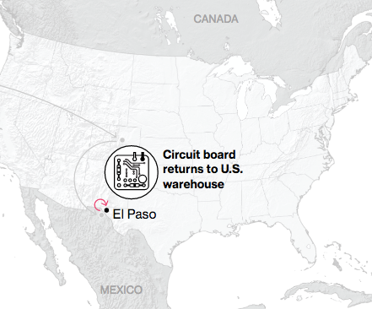
NAFTA and the Auto Supply Chain
Black, Diamond, and Merrill, “One Tiny Widget’s Dizzying Journey Shows Just How Critical Nafta Has Become,” Bloomberg, February 2, 2017.

Slide 59
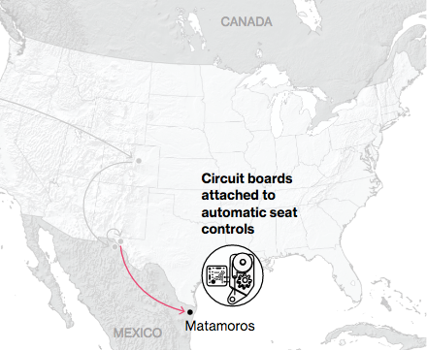
NAFTA and the Auto Supply Chain
Black, Diamond, and Merrill, “One Tiny Widget’s Dizzying Journey Shows Just How Critical Nafta Has Become,” Bloomberg, February 2, 2017.

Slide 60
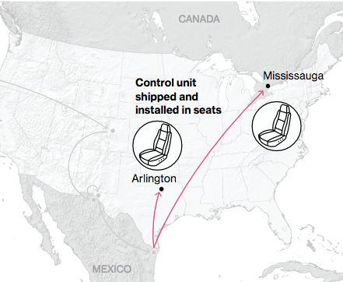
NAFTA and the Auto Supply Chain
Black, Diamond, and Merrill, “One Tiny Widget’s Dizzying Journey Shows Just How Critical Nafta Has Become,” Bloomberg, February 2, 2017.

Slide 61
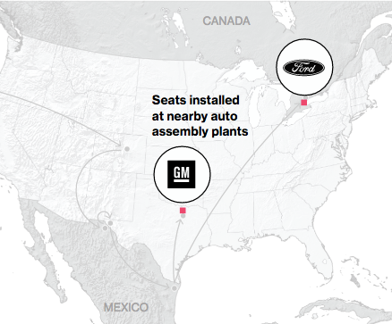
NAFTA and the Auto Supply Chain
Black, Diamond, and Merrill, “One Tiny Widget’s Dizzying Journey Shows Just How Critical Nafta Has Become,” Bloomberg, February 2, 2017.

Slide 62
Supply Chains
Example: The iPhone assembled in China from parts:
Part | Come from
﻿Accelerometers | ﻿Germany, the US, South Korea, China, Japan, and Taiwan.
﻿Audio chips | ﻿US, UK, China, South Korea, Taiwan, Japan, and Singapore.
﻿Batteries | ﻿Samsung (South Korea), which has factories in eighty countries.
﻿Cameras | ﻿Qualcomm (US) and Sony (Japan), both with plants in many countries
﻿Chips ﻿for 3G/4G/LTE networking | ﻿Qualcomm (US)
﻿Compasses | ﻿AKM Semiconductor (Japan) with plants in the US, France, England, China, South Korea, and Taiwan.
﻿Glass screen | ﻿Corning (US) with plants in twenty-six countries.
﻿Gyroscopes | Switzerland
… and many more
Source: Krueger 2020
Notes:
Krueger, Anne O., International Trade (What Everyone Needs to Know) (p. 254). Oxford University Press, 2020

Slide 63
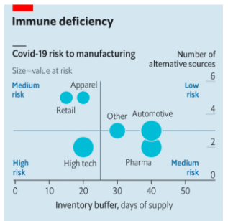
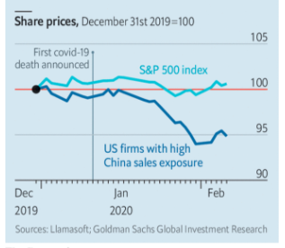
The new coronavirus could have a lasting impact on global supply chains
2021 Chip Shortage
What sectors are most vulnerable?
Those with small inventories and few alternative sources.
Source: Economist Feb 15, 2020
Notes:
Economist Feb 15, 2020
https://www.economist.com/international/2020/02/15/the-new-coronavirus-could-have-a-lasting-impact-on-global-supply-chains

Slide 64
Effects on Economies
Other Supply Chain Vulnerabilities
  Brexit
  Texas storm and freeze
  Suez blockage
  Ban on imports from Xinjiang, China
  Chip shortage

Slide 65
Effects on Trade Policies

Slide 66
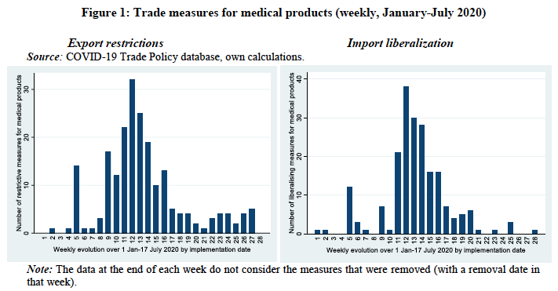
Source: Hoekman et al. (2020)
Notes:
Hoekman, Bernard, Anirudh Shingal, Varun Eknath and Viktoriya Ereshchenko, “COVID-19, public procurement regimes and trade policy,” EUI Working Paper RSCAS 2020/72, European University Institute, November 2020.
https://cadmus.eui.eu/bitstream/handle/1814/68839/RSCAS_2020_72.pdf?sequence=1&isAllowed=y

Slide 67
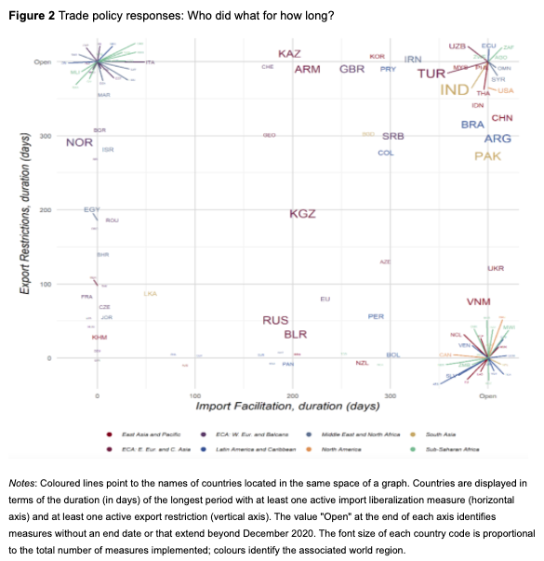
Countries with only export restriction, extending beyond 2020
Trade Policy Responses: Who did what for how long?
Countries with both import facilitation and export restriction, extending beyond 2020
USA
Inc. Italy
Inc. India
Brazil
China
Countries differ greatly in the nature of their interventions
Countries with only import facilitation, extending beyond 2020
Inc. Canada
Source: Evenett et al.
Notes:
Evenett, Simon, Matteo Fiorini, Johannes Fritz, Bernard Hoekman, Piotr Lukaszuk, Nadia Rocha,Michele Ruta, Filippo Santi, Anirudh Shingal, “Trade policy responses to the COVID-19 pandemic: Evidence from a new dataset,” VOXEU, December 11, 2020.
https://voxeu.org/article/trade-policy-responses-covid-19-pandemic-new-dataset

Slide 68
Effects on Trade Policies
Effects of the Pandemic on Trade Policies
  Export Policies
  Import Policies

Slide 69
Export Policies
Effects on Trade Policies

Slide 70
Effects on Export Policies
Export Policies
  There were export bans by many countries on
    Medical supplies
    Food
    Other
  Some were temporary, but many others were not
  Only a few countries had policies to encourage exports

Slide 71
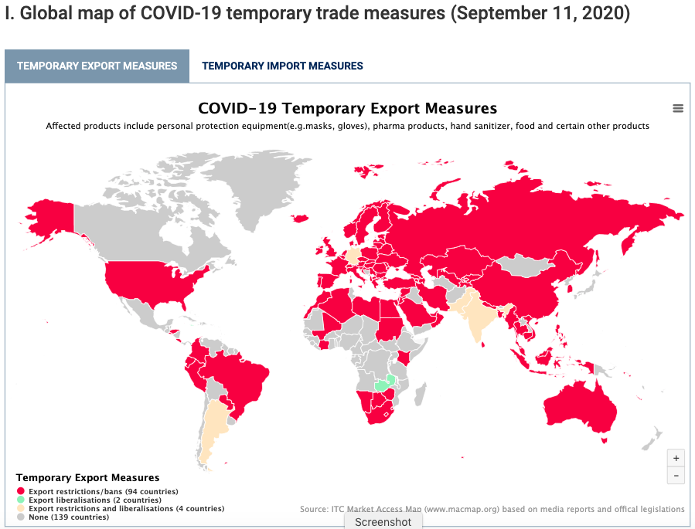
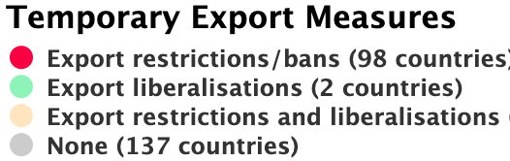
Source: ITC
Notes:
ITC Market Access Map
https://www.macmap.org/covid19

Slide 72
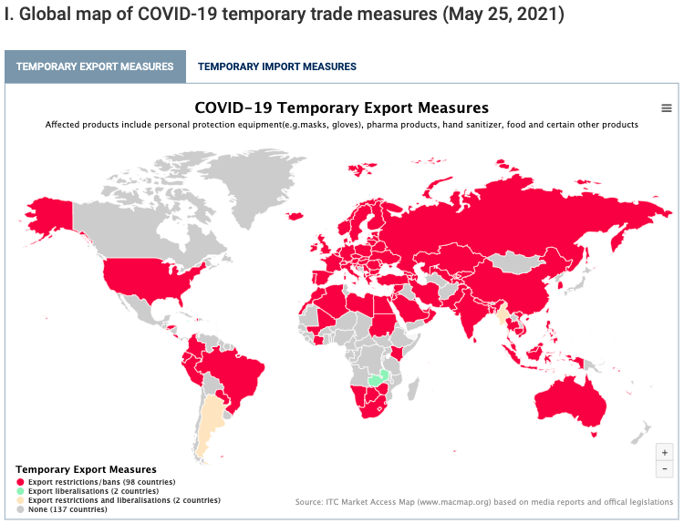
Source: ITC
Notes:
ITC Market Access Map
https://www.macmap.org/covid19

Slide 73

Source: WTO (2020)
Notes:
WTO, “Report on G-20 Trade Measures (Mid-October 2019 to Mid-May 2020),” World Trade Organization, June 29, 2020.
https://www.wto.org/english/news_e/news20_e/report_trdev_jun20_e.pdf

Slide 74
Import Policies
Effects on Trade Policies

Slide 75
Effects on Import Policies
Effects of the Pandemic on Import Policies
  Import expansion
    Tariff reductions
  Import contraction
    Tariff increases
    Import bans
    Government procurement

Slide 76


Source: ITC
Notes:
ITC Market Access Map
https://www.macmap.org/covid19

Slide 77

Source: ITC
Notes:
ITC Market Access Map
https://www.macmap.org/covid19

Slide 78
Trade during the Pandemic

Slide 79
Role of Trade During Pandemic
Trade in COVID-19 Critical Goods
  Trade increased, especially in PPE but also medical
  Largest importer was US, both before and during
  Largest exporter, after a lag, was China
  Facemasks
    Textile facemasks grew most
    As did China’s imports of the textiles
    In spite of high import tariffs
Notes:
“Trade in Medical Goods in the Context of Tackling COVID-19: Developments in the First Half of 2020,” Information Note, World Trade Organization, December 22, 2020
https://www.wto.org/english/tratop_e/covid19_e/medical_goods_update_e.pdf

Slide 80

Source: UNCTAD
Notes:
UNCTAD,
https://unctad.org/webflyer/impact-covid-19-pandemic-trade-and-development-transitioning-new-normal Impact of the Covid-19 Pandemic on Trade and Development, 2020.

Slide 81

Source: WTO
Notes:
“Trade in Medical Goods in the Context of Tackling COVID-19: Developments in the First Half of 2020,” Information Note, World Trade Organization, December 22, 2020
https://www.wto.org/english/tratop_e/covid19_e/medical_goods_update_e.pdf

Slide 82

Source: WTO
Notes:
“Trade in Medical Goods in the Context of Tackling COVID-19: Developments in the First Half of 2020,” Information Note, World Trade Organization, December 22, 2020
https://www.wto.org/english/tratop_e/covid19_e/medical_goods_update_e.pdf

Slide 83

Source: WTO
Notes:
“Trade in Medical Goods in the Context of Tackling COVID-19: Developments in the First Half of 2020,” Information Note, World Trade Organization, December 22, 2020
https://www.wto.org/english/tratop_e/covid19_e/medical_goods_update_e.pdf

Slide 84
Role of Trade During Pandemic
Trade counterfeit goods
  Ramirez reports, from OECD data, that
    Criminal organisations have taken advantage of public fear to sell defective PPE and COVID-19 tests, faulty ventilators and other medical products, and even fictitious treatments and miracle cures
Notes:
“Trade in Medical Goods in the Context of Tackling COVID-19: Developments in the First Half of 2020,” Information Note, World Trade Organization, December 22, 2020
https://www.wto.org/english/tratop_e/covid19_e/medical_goods_update_e.pdf

Slide 85

Source:
Ramirez (2020)
Notes:
Ramirez, David, “COVID-19: Global trade and supply chains after the pandemic,” IISS, The International Institute for Strategic Studies, Research paper, August 27. 2020.
https://www.iiss.org/blogs/research-paper/2020/08/covid-19-trade-and-supply-chains

Slide 86
Role of Trade During Pandemic
Vaccines
  Vaccine industry relies heavily on trade
  Concerns
    Distribution to the poorest countries
    Reluctance to be vaccinated
    Vaccine nationalism
Notes:
“Trade in Medical Goods in the Context of Tackling COVID-19: Developments in the First Half of 2020,” Information Note, World Trade Organization, December 22, 2020
https://www.wto.org/english/tratop_e/covid19_e/medical_goods_update_e.pdf

Slide 87

Source: WTO, Dec 22, 2020
Notes:
WTO, “Developing and Delivering Covid-19 Vaccines around the World,” information note, World Trade Organization, December 22, 2020.
https://www.wto.org/english/tratop_e/covid19_e/vaccine_report_e.pdf

Slide 88

Source: Bloomberg, May 26, 2021
Notes:
“More Than 1.74 Billion Shots Given: Covid-19 Tracker,” Bloomberg, May 26, 2021
https://www.bloomberg.com/graphics/covid-vaccine-tracker-global-distribution/

Slide 89

Source: Economist Feb 6. 2021
Notes:
Economist, “Africa’s recovery from covid-19 will be slow,” The Economistci, Febuary 6, 2021
https://www.economist.com/middle-east-and-africa/2021/02/06/africas-recovery-from-covid-19-will-be-slow

Slide 90

Agreement that “vaccines are safe”
Source:
Kuman
(December 2020)
Notes:
Kumar, Ravi, “Business has a big role to play in vaccinating the world,” World Economic Forum, December 15, 2020.
https://www.weforum.org/agenda/2020/12/business-has-a-big-role-to-play-in-vaccinating-the-world/

Slide 91

Source: Economist Feb 13, 2021
Notes:
Economist, “Fear, uncertainty and doubt: Vaccine hesitancy is putting progress against covid-19 at risk,” The Economist, Feb 13, 2021
https://www.economist.com/briefing/2021/02/13/vaccine-hesitancy-is-putting-progress-against-covid-19-at-risk

Slide 92
Vaccine Nationalism
Vaccine Nationalism
  Some countries seek to restrict exports of vaccines until their own populations are served.
  On Jan 29, the EU announced export controls on COVID-19 vaccines
  US only recently announced it would export vaccines
  India exported many, but stopped when their cases surged
  I have had audience members hope that the US will not export vaccines until all Americans are vaccinated
  If this were done, it would slow the world’s progress toward managing the pandemic
Notes:
https://iccwbo.org/media-wall/news-speeches/study-shows-vaccine-nationalism-could-cost-rich-countries-us4-5-trillion/
https://foreignpolicy.com/2021/02/02/vaccine-nationalism-harms-everyone-and-protects-no-one/
https://www.theguardian.com/commentisfree/2021/feb/02/vaccine-nationalism-hiv-covid
https://www.newscientist.com/article/mg24933201-800-vaccine-nationalism-will-leave-everyone-more-at-risk-of-coronavirus/
https://fortune.com/2021/01/31/covid-vaccine-nationalism-coronavirus-pandemic-length-when-will-it-end/

Slide 93

Source: Washington Post Apr 22, 2021
Notes:
Mirza, Atthar and Emily Rauhala, “Here’s just how unequal the global coronavirus vaccine rollout has been,” Washington Post, April 22, 2021.
https://www.washingtonpost.com/world/interactive/2021/coronavirus-vaccine-inequality-global/?utm_campaign=wp_todays_headlines&utm_medium=email&utm_source=newsletter&wpisrc=nl_headlines&carta-url=https%3A%2F%2Fs2.washingtonpost.com%2Fcar-ln-tr%2F3205385%2F6083ec299d2fda39cec7c8a4%2F597273baade4e21a847d94bd%2F15%2F57%2F6083ec299d2fda39cec7c8a4

Slide 94


Source:
Notes:
https://ourworldindata.org/covid-vaccinations

Slide 95

Source:
Notes:
https://ourworldindata.org/covid-vaccinations

Slide 96

Source: Statista
May 26, 2021
Notes:
Source: Statista May 26, 2021
https://www.statista.com/chart/24555/vaccine-doses-produced-and-exported/

Slide 97
Vaccine Nationalism
COVAX
  An initiative launched the World Health Organization, the European Commission, and France to provide vaccines to people in all countries regardless of wealth
  May 17, 2021: “The COVAX Facility will deliver its 65 millionth vaccine dose this week. It should’ve been at least its 170 millionth. The time to donate excess doses is now.”
Notes:
https://iccwbo.org/media-wall/news-speeches/study-shows-vaccine-nationalism-could-cost-rich-countries-us4-5-trillion/
https://foreignpolicy.com/2021/02/02/vaccine-nationalism-harms-everyone-and-protects-no-one/
https://www.theguardian.com/commentisfree/2021/feb/02/vaccine-nationalism-hiv-covid
https://www.newscientist.com/article/mg24933201-800-vaccine-nationalism-will-leave-everyone-more-at-risk-of-coronavirus/
https://fortune.com/2021/01/31/covid-vaccine-nationalism-coronavirus-pandemic-length-when-will-it-end/

Slide 98

Source: Wikipedia May 16, 2021
Notes:
https://en.wikipedia.org/wiki/COVAX

Slide 99

Source: McCarthy, Feb 22, 2021
Notes:
McCarthy, Niall, “The Governments Donating The Most Money To COVAX,” Statista, Feb 22, 2021
https://www.statista.com/chart/24244/donations-to-covax-by-country/

Slide 100

Source:
UNICEF
Covid-19 Vaccine Market Dashboard
May 26, 2021
Notes:
https://app.powerbi.com/view?r=eyJrIjoiNmE0YjZiNzUtZjk2OS00ZTg4LThlMzMtNTRhNzE0NzA4YmZlIiwidCI6Ijc3NDEwMTk1LTE0ZTEtNGZiOC05MDRiLWFiMTg5MjAyMzY2NyIsImMiOjh9&pageName=ReportSectiona329b3eafd86059a947b

Slide 101
Conclusion
The Covid-19 Pandemic has had
  Serious effects on global trade
  Mostly adverse effects on international trade policies
How much of this will be permanent remains to be seen

Slide 102
Thank you!
Thank you!
Any Questions?
Alan V. Deardorff
Ford School of Public Policy
University of Michigan
www.NEEDelegation.org

